Slide 1

Canadian Counselling Psychology: Recent Advancements & Continuing Debates
José F. Domene
University of New Brunswick
Fredericton, NB

Slide 2
Overview
Growth as a distinct specialization in Canada
Development of a Canadian definition of counselling psychology
Expansion of the Literature about the Profession in Canada
What should we do about the predoctoral internship situation?
What should our relationship be with counselling & counsellor education?

Slide 3
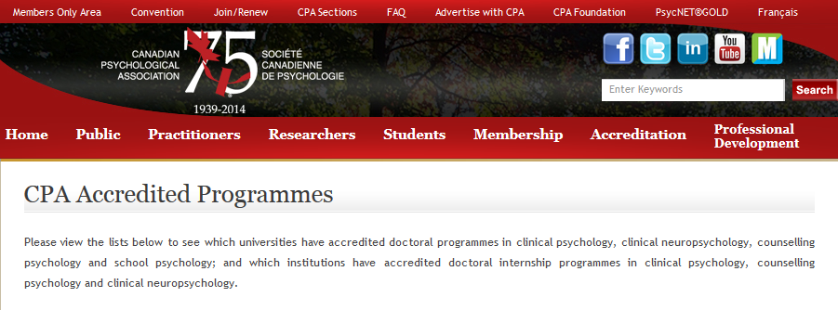
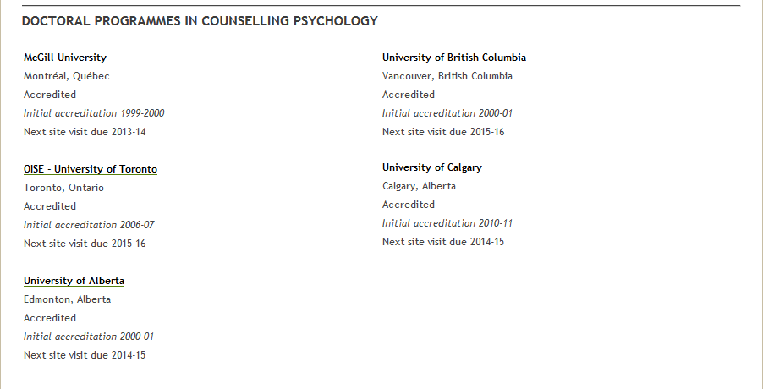
Growth as a Specialization in Canada
Notes:
First program accredited in 1999 (McGill),
followed by U of A and UBC in 2000, OISE in 2006, and U of C in 2010
5 programs currently accredited, and rumors that a couple more programs may be in development
Paralleling this growth in accredited programs has been growth in section membership
Note that I grabbed these data from the Annual Reports in our publicly available Section Archives, but the information was not available in some year (including in the 90s, when the reports didn’t include membership info).
Anyway, you can see that the trend is not linear, and we experienced a bit of a dip in 2005, but it’s generally an upward trend,
We started with 122 members in 1987, and just this year, I believe we exceeded 400 members in the section.

Slide 4
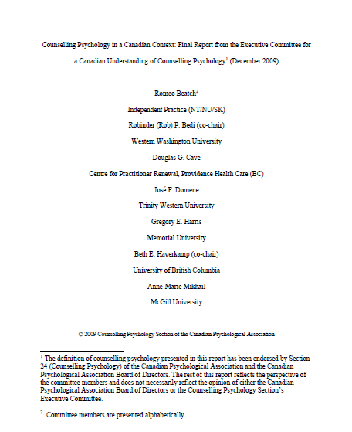
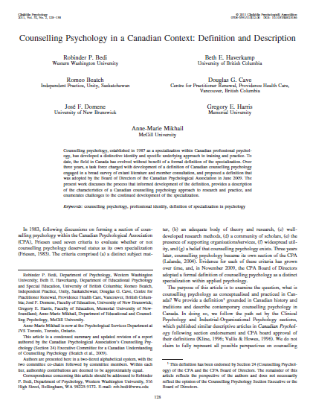
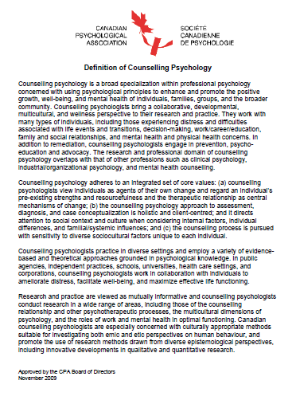
Canadian Definition of Counselling Psychology
Notes:
In the late 80s and early 90s, as we were developing as a specialization within professional psychology in Canada, we tended to borrow a lot from Division 17 of the American Psychological Association.
And that’s excellent. Given the nature of the US and Canada, and the relationship between CPA and APA, I think that there will always be a place for close connection and collaboration between our US counterparts and ourselves.
However, as early as 1996, the Chair of the section at that time, Richard Young, noted the absence of a formal definition of the profession in Canada and, by the mid-2000s, there was a strong sense that we should really have our own definition of the profession as it exists within the Canadian context.
In response to requests from the membership, in 2007, Vivian Lalande, then Chair of the Section, commissioned an ad-hoc committee to develop such a definition.
The process ended up taking about 2 ½ years, with a couple of iterations of presenting drafts to the Section membership for review,
and ongoing, and sometimes quite “vigorous,” debate within the committee itself until we arrived at this rather LONG definition (which was embedded in an even longer report… 60 pages + 20 pages of appendices)
Anyway, in June 2009, it was approved by the Section and endorsed by CPA’s Board of Directors
Finally, in 2011, we published an article describing the definition and its implications in the journal “Canadian Psychology.”
Discussing the content and implications of the definition would be another whole Keynote talk in itself, so instead, I’m going to invite you to download these documents from our Section web-page and peruse them yourself,
Or, if you want the short version, the article was published in the November 2011 issue of Canadian Psychology (which you have free electronic access to as a member of CPA).
Anyway, I’m hoping that the definition has spurred, and will continue to spur ongoing discussion about what it means to practice Counselling Psychology in Canada; what it means to be a Counselling Psychologist.

Slide 5
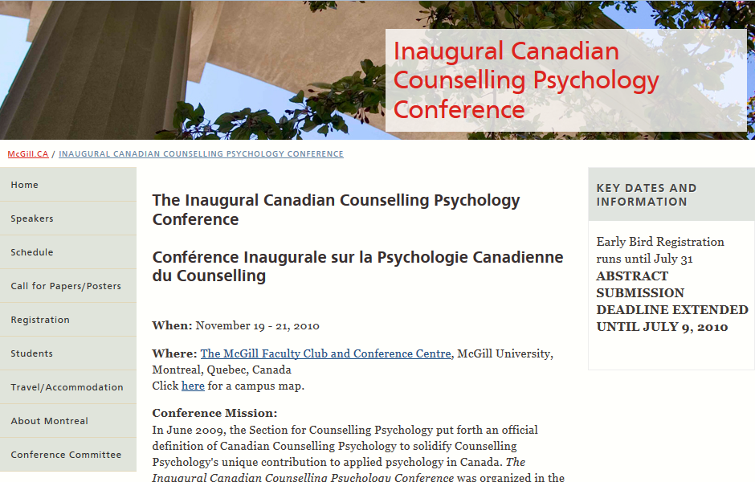
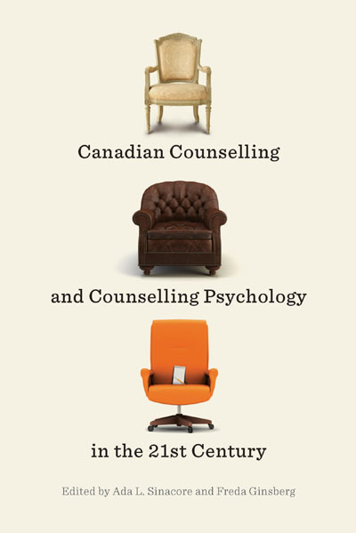
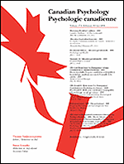
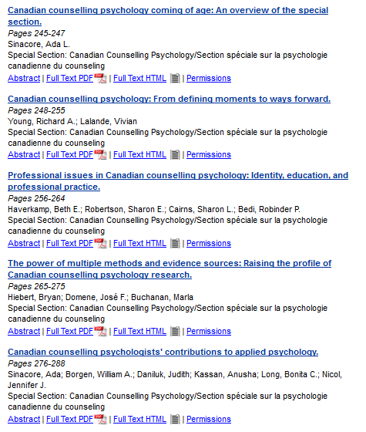
Expansion of the Literature about the Profession
Notes:
One of the things that has been spurred on at least in part by the definition is increased systematic reflection and writing about the profession of counselling psychology in Canada.
And at this point, I really need to acknowledge the work of newly-made “Fellow” of the CPA, and the woman who has been Chair of the section over the last two years, Ada Sinacore,
as a driving force in stimulating interest and dialogue about who we are and what we do as Canadian Counselling Psychologists.
Among the things that she helped to make happen are:
the “Inaugural Canadian Counselling Psychology Conference” in 2010 (which I believe was the first ever conference specifically devoted to counselling psychology in Canada)
(b) A special section, comprising 5 articles published in 2011, in the journal “Canadian Psychology” [if time, mention the topics: (a) the history of Canadian counselling psychology; (b) professional issues and identity; (c) counselling, training, and supervision; (d) research and scientific issues; and (e) counselling psychologists' contribution to applied psychology]
(c) And, coming out early in the new year, an edited book addressing many aspects of the practice of Counselling Psychology in Canada.
I’m not saying that these are the first or the only articles on the subject, but they are reflective of the recent growth in the literature being generated about Canadian counselling psychology.
This is excellent, because the more we are able to read and teach from our own literature, the less we will have to rely on literature from other countries (which may not accurately reflect the practice of the profession in Canada).
Alongside the expanding literature about our profession has been a parallel expansion in our presence at the CPA conference.
Unfortunately, I havn’t been able to find much detailed information on the numbers of posters, symposia and other sessions that are offered through our Section.
However, in the 10 years that I have been attending the conference, my impression is that our Section-related content has grown by leaps and bounds.
I remember being quite disappointed by the lack of Counselling Psychology content at one of the first CPA conferences that I attended in 2004, in NFLD.
In the last couple of conferences, I have had the exact opposite problem: There is so much counselling-related content that it is impossible to attend everything I want to!

Slide 6
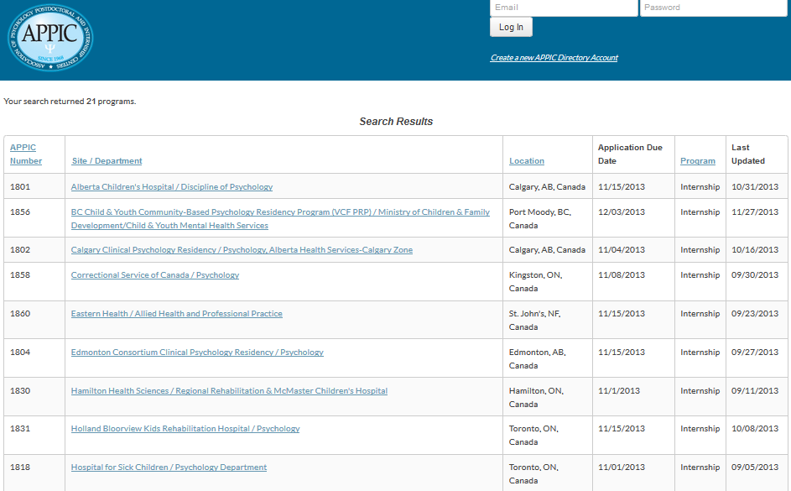
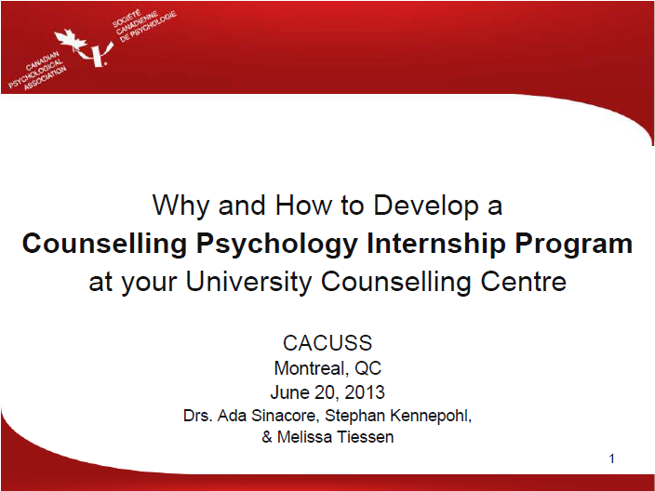
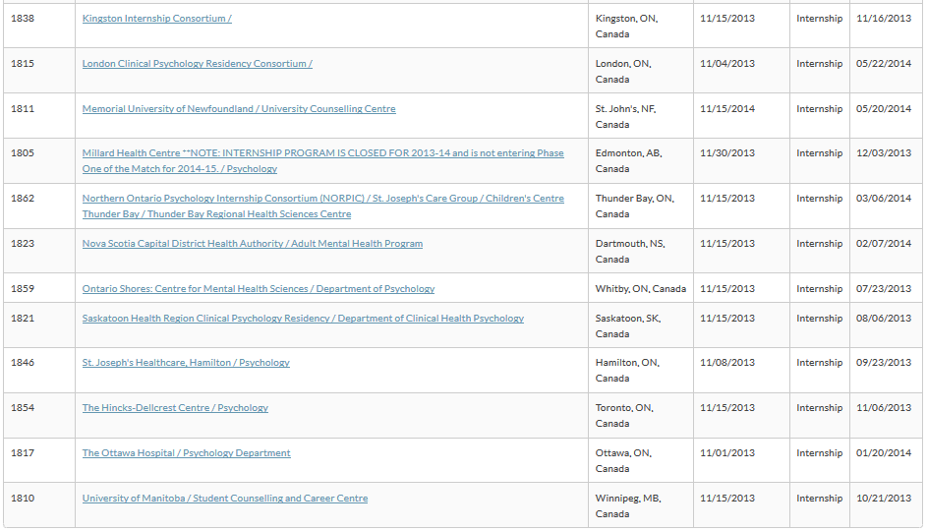

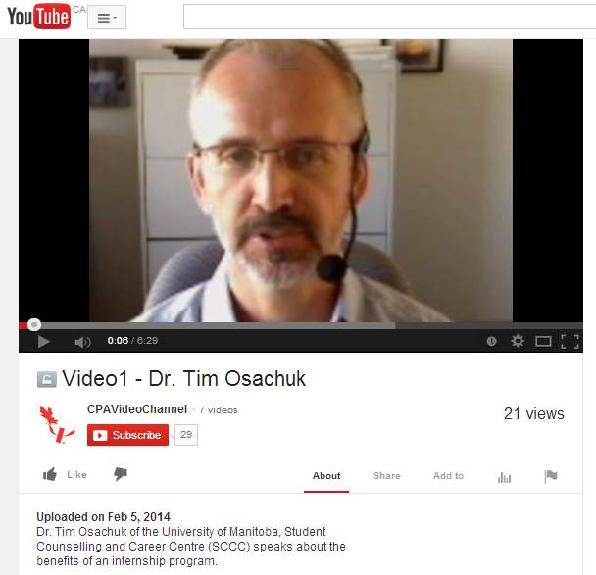
The Pre-Doctoral Internship Situation
Notes:
If you are a student approaching internship year, or if you are a faculty member involved with program re-accreditation, or if you have simply been attending the last few Annual Meetings of our Section,
you will know that there is a shortage of accredited pre-doctoral internship sites in Canada.
I might not be the best person to sketch out the debate around this issue, since I completed a post-doctoral rather than a pre-doctoral internship for my licensure,
But I do have some insight from being involved in developing a predoctoral internship program at UNB (we’ll be starting with our first doctoral intern this September, so even seeking accreditation is a ways down the road)
Anyway, a quick search of the APPIC directory 21 sites in Canada where counselling psychology students are listed as “acceptable.” This sounds reasonable, until you consider that:
NOT all these sites are accredited; (b) only 5 of the accredited sites list counselling psych students as “preferred” applicants; and one of those 5 sites isn’t accepting any students in the next round of applications.
So, given this situation, the question arises around what we as a Section, and as individuals who care about the development of the profession, can and should do to address this problem.
One approach is to connect with and convince more of the existing internship sites to seriously consider counselling psychology applicants for placement….
Either just to allow us to apply, in the case of the 14 Canadian sites that won’t even consider applicants from our specialization
Or to move us up from “acceptable” to “preferred” applicants in the case of the remainder.
I know that some of you have been actively engaged in the process of convincing sites of the value of having counselling psychology interns,
and of course our most convincing argument is when our interns actually get into these sites, and they exceed expectations and challenge prevalent stereotypes about what counselling psychologists can and cannot do.

Slide 7
The Pre-Doctoral Internship Situation (cont.)
Notes:
However, getting into more of the existing accredited sites can not be the entire answer, for a couple of reasons:
(a) The shortage of internship sites isn’t limited to counselling psych; it’s present across the specializations of professional psychology in both Canada and the US,
It’s not as if there are internship spots that are simply waiting to be filled if we could only make the directors aware of our value…
(actually, when you look at the numbers of clinical psych students in Canada seeking internships each year, and the number of spaces available in the country, the situation is just as dire for them as for us)
(b) A more subtle but potentially more concerning issue is that the internship experience is one of the most important formative experiences for students entering professional practice, right?
Well, what does it mean for our students’ professional worldview and approach to working with clients, if this key experience takes place in a setting where the dominant paradigm is clinical psychology, and the student is supervised by clinical psychologists?
The better alternative is work towards developing additional internship opportunities, (preferably at sites where there is a good fit between the way they work and the Canadian counselling psychology approach to practice)
Our Section executive has been actively involved with CPA head office to do this, presenting at CAUCUSS, and preparing resources that can be used in preparing arguments for conversations with CS staff.
The slides from Ada’s presentation are available for download from CPA’s web-site,
and inn those slides are links to Youtube videos by George Hurley and Tim Osacuk (who are involved with the internships at Memorial and U Manitoba, respectively)…
they do a great job of outlining the advantages of having doc student interns, and the pragmatics of getting such a program off the ground.
Those materials, especially the videos from folks working in university counselling centres were instrumental in convincing the Director of CS at UNB to pursue pre-doc internships.
So, as part of the debate around what to do about our internship shortage …
for those of you who are faculty members with good relationships with your university’s CS; if they aren’t already taking doctoral-level interns,
I challenge you to have a conversation with them about that, and present them with the case for developing such a program
(and if you want, I’d be happy to chat 1-on-1 with you about my experience and involvement in getting the internship set up at UNB)

Slide 8

Relationship with Counselling-Psychotherapy
Notes:
As we continue to establish and assert our identity as a distinct specialization with a distinct perspective within professional psychology,
The question arises as to what should be our relationship with those folks who, in Atlantic Canada, call “counselling therapists “or “Counseilleurs d’ Orientation”
(and I’m not sure what the name is on the West Coast… “clinical counsellors”? “Psychotherapists?”)
This is becoming a more and more salient issue because, not only is Counselling Psychology becoming more active in asserting it’s professional identity,
but so too is Counselling Therapy, with efforts to define it’s scope of practice and achieve regulation of the profession actively underway (or achieved) in many provinces
Before I engage with this debate, full disclosure… I am a licensed psychologist, but I am also a counsellor educator, and I am actively involved in both CPA and CCPA.
One possible direction that counselling psychology can take to maintain our distinct identity is to increase the separation from counselling, for us to go our way and they to go theirs…
Paralleling what has happened in the United States
Even if we set aside the question of whether it is actually working in the States (I happen to think that the costs in terms of the fragmentation and conflict that has emerged among the mental health professions is a negative rather than positive development),
There are several reasons why I don’t think this is the right solution:
(a) It goes against the history of our profession in Canada, which is rooted as much in Counselling & Counsellor education as it is in Psychology.
And that history directly informs the definition of Counselling Psychology in Canada. If we separate ourselves from our history, in the long run this will have an effect on our distinct identity
(b) On another, more pragmatic, basis, how would we even go about separating counselling and counselling psychology, when (as Sharon Robertson so aptly put it in the Section Keynote two years ago), “They are Us.”
How many of the PhD Counselling Psychology programs are co-located with master’s level counsellor education programs, sharing courses, program resources, and professors?
What proportion of doctoral students practiced as counselling therapist before pursuing doctoral studies (or even during the PhD)?
And on the flip side, where do the counsellor education programs tend to draw on when they are hiring faculty members?

Slide 9
Notes:
So, my position in this debate is that we should not be working toward keeping the drawbridge open to increase the separation between counselling psychology and counselling therapy,
But instead be closing the drawbridge; that is maintaining more open communication and collaboration between the two professions, working together while still recognizing that the two are distinct professions.
Will this muddy our identity and cause confusion among our students? Potentially, but it certainly doesn’t have to, if we discuss both professions, where they overlap and where they differ, in our training programs.
Indeed, explicit discussions within our courses, combined with a willingness for faculty members to take on both identities for ourselves (rather than “othering” one side) may actually help students develop a clearer sense of identity.
When I finally got around to pursuing licensure and adopting the identity of “practitioner” I didn’t become any less of an academic; I added the “practitioner” identity onto my identities as a researcher and educator.
Similarly, after I immigrated to Canada, I gradually added a Canadian cultural identity on top of my Chinese and Mexican cultures; I didn’t drop my previous cultural identities. Indeed, adopting a Canadian identity encouraged me to become more reflective about what it means to be Chinese and Mexican.
In the same way, I believe it is possible to be “both/and”: I am a psychologist who also does counselling; I am a counsellor educator who also teaches students who are planning to pursue a PhD in Counselling Psychology down the road.
And adopting both identities may actually lead to more reflective thinking about what it means to be a counselling psychologist.
So, what’s the way forward for us as counselling psychologists as we respond to what’s going on for us as counselling therapists and educators? Well, my position in the debate is that we should:
Become more comfortable with the idea of adopting multiple identities, rather than having to choose one or the other
(b) Have respectful and explicit discussions about professional identities in our master’s-level classes, outlining both the distinctives and the overlaps between counselling psychology and counselling therapy
(c) Create more opportunities for collaboration rather than conflict, and seeking to work together to address issues that affect all of us.
For example, one concrete step that the Section executive could take create a formal liaison position with the CE chapter of CCPA, or add it on to the duties of one of the existing positions on the exec.
[given that we have several members of the Chapter’s exec right here in the room, it probably won’t be too difficult to get that conversation going]

Slide 10
Thanks for Listening
&
Time for Discussion

